Slide 1
RECURSION
Self referential functions are called recursive (i.e. functions calling themselves)
Recursive functions are very useful for many mathematical operations

Slide 2
Factorial: Recursive Functions
1! = 1
2! = 2*1 = 2*1! So: n! = n*(n-1)! For N>1
3! = 3*2*1 = 3*2! 1! = 1
4! = 4*3*2*1 = 4 * 3!
Properties of recursive functions:
1) what is the first case (terminal condition)
2) how is the n^{th} case related to the (n-1)^{th} case
Or more general: how is n^{th} case related to <n^{th} case

Slide 3
Recursive procedure
A recursive task is one that calls itself. With each invocation, the problem is reduced to a smaller task (reducing case) until the task arrives at a terminal or base case, which stops the process. The condition that must be true to achieve the terminal case is the terminal condition.

Slide 4
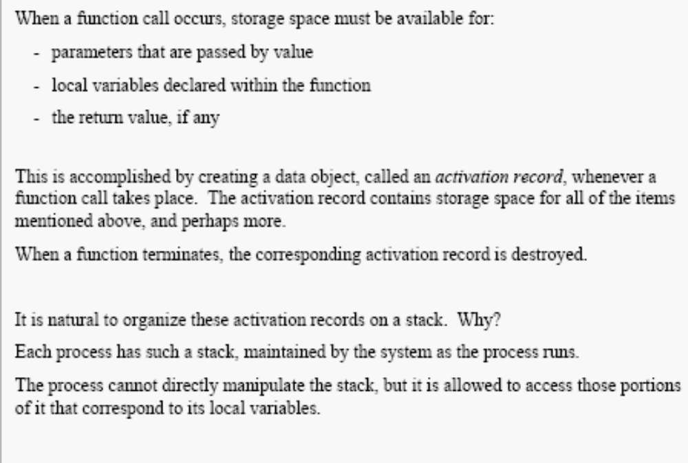

Slide 5
#include <iostream.h>
long factorial(int); // function prototype
int main()
{
int n; long result;
cout << "Enter a number: ";
cin >> n;
result = factorial(n);
cout << "\nThe factorial of " << n << " is " << result << endl;
return 0;
}
long factorial(int n)
{
if (n == 1)
return n;
else
return n * factorial(n-1);
}
Terminal condition to end recursion

Slide 6
long factorial(int n)
{
if (n == 1)
return n;
else
/* L#6 */ return n * factorial(n-1);
}
n=1
Return value
1
Addr of calling statement
L#6: return 2 * factorial(1)
n=2
Return value
2*1
L#6: return 3 * factorial(2)
Addr of calling statement
n=3
Reserved for return value
3*2
Main program:
result = factorial(3)
Addr of calling statement
******

Slide 7
Iterative solution for factorial:
int factorial (int n)
{
int fact;
for (fact = 1;n>0; n--)
fact=fact*n;
return fact
}
Recursive functions can always be “unwound” and written iteratively

Slide 8
Example 2: Power function
x^{n} = 1 if n = 0
= x * x^{n-1} if n>0
5³ = 5 * 5²
5² = 5 * 5¹
5¹ = 5 * 5⁰
5⁰ = 1

Slide 9
Return 1
float power(float x, int n)
{
if (n == 0) return 1;
else
return x * power (x, n-1);
}
X=5, n=0
5 * power(5,0)
X=5, n=1
5 * power(5,1)
X=5, n=2
5 * power(5,2)
X=5, n=3
Power(5,3)
******

Slide 10
Power function x^{n}
Thus for n= 3, the recursive function is called 4 times, with n=3, n=2, n=1, and n=0
in general for a power of n, the function is
called n+1 times.
Can we do better?

Slide 11
We know that :
x¹⁴ = (x⁷)² in other words: (x⁷ * x⁷)
x⁷ = x (x³)²
int (7/2) = 3
x³ = x (x¹)²
x^{n} = 1 if n= 0
= x(x^{n/2})² if n is odd
= (x^{n/2})² if n is even
x¹ = x (x⁰)²
x⁰ = 1
Floor of n/2

Slide 12
float power (float x, int n)
{
float HalfPower;
//terminal condition
if (n == 0) return 1; //can also stop at n=1
//if n Is odd
if (n%2 == 1)
{
HalfPower = power(x,n/2);
return (x * HalfPower *HalfPower):
} else
{ HalfPower = power(x,n/2);
return (HalfPower * HalfPower);
}
****

Slide 13
if (n == 0) return 1;
if (n%2 == 1)
{
HalfPower = power(x,n/2);
return (x * HalfPower *HalfPower):
} else
{ HalfPower = power(x,n/2);
return (HalfPower * HalfPower);
}
Can also use the call:
return power(x,n/2) * power (x,n/2)
But that is much less efficient!

Slide 14
Recursive Power Function: divide & conquer
How many calls to the power function does the second algorithm make for x^{n}?
Log₂(n)!!!!
**

Slide 15
Parts of a Recursive Function:
recursive_function (….N….)
{
//terminal condition
if (n == terminal_condition) return XXX;
else {
…
recursive_function(….<N….);
}
1.
2.

Slide 16
int main(void)
{ int z;
z= f ( f(2) + f(5));
cout << z;
}
int f(int x)
{
int returnvalue;
if (x==1) || (x== 3)
return x;
else return (x * f(x-1))
}
Recursion Example
What gets printed?
(2 + 60)! / 2
**

Slide 17
Recursion: Example 4
Write a recursive boolean function to return
True (1) if parameter x is a member of
elements 0 through n of an array.

Slide 18
bool inarray(int a[], int n, int x)
{
if (n<0) return FALSE;
else if (a[n] == x) return TRUE;
else return inarray(a,n-1,x);
}

Slide 19
Write a recursive function that takes a string and prints it reversely.
int main()
{
  char cList[] = ”abcdefghijk”;
  rPrint(cList);
  return 0;
}
int rPrint(char *L) // reversely print a string starting at L
{
  if (*L == '\0’) return 0;
  rPrint(L+1);
  cout <<*L<<endl;
  return 0;
}

Slide 20
What is a better name for this function? (i.e., what does it do?)
int main()
{
  int RandyJackson[] = {1, 2, 3, 4, 5, 6, 7, 8, 9, 99};
  int *paula;
  paula = RandyJackson;
  AmericanIdol(paula);
  return 0;
}
int AmericanIdol(int *simon)
{
  if (*simon == 99) return 0;
  AmericanIdol(simon+1);
  cout <<*simon<<endl;
  return 0;
}

Slide 21
Algorithm Analysis & Complexity
We saw that a linear search used n comparisons in the worst case (for an array of size n) and binary search had logn comparisons. Similarly for the power function -- the first one took n multiplications, the second logn. Is one more efficient than the other?
How do we quantify this measure?

Slide 22
Efficiency
CPU (time) usage
memory usage
disk usage
network usage
1.Performance: how much time/memory/disk/... is actually used when a program is run. This depends on the machine, compiler, etc. as well as the code.
2.Complexity: how do the resource requirements of a program or algorithm scale, i.e., what happens as the size of the problem being solved gets larger.
Complexity affects performance but not the other way around.

Slide 23
The time required by a method is proportional to the number of "basic operations" that it performs. Here are some examples of basic operations:
one arithmetic operation (e.g., +, *).
one assignment
one test (e.g., x == 0)
one read
one write (of a primitive type)

Slide 24
Constant Time vs. Input Size
Some algorithms will take constant time -- the number of operations is independent of the input size.
Others perform a different number of operations depending upon the input size
For algorithm analysis we are not interested in the EXACT number of operations but how the number of operations relates to the problem size in the worst case.

Slide 25
Big Oh Notation
The measure of the amount of work an algorithm performs of the space requirements of an implementation is referred to as the complexity or order of magnitude and is a function of the number of data items.
We use big oh notation to quantify
complexity, e.g. O(n), or O(logn)

Slide 26
Big Oh notation
O notation is an approximate measure and is used to quantify the dominant term in a function.
For example, if f(n) = n³ + n² + n + 5
then f(n) = O(n³)
(since for very large n, the n³ term
dominates)

Slide 27
Big Oh notation
For n = 5, the values in the array get printed (25 gets printed). After each row a new line gets printed (5 of them)
Total work = n² +n
= O(n²)
for (I = 0; I<n; I++)
{
for (j=0; j<n; j++)
cout << a[I][j] << “ “;
cout << endl;
}
For n = 1000, a[I][j] gets printed 1000000
times, endl only 1000 times.

Slide 28
Big Oh Definition
Function f is of complexity or order at most g, written with big-oh notation as f = O(g), if there exists a positive constant c and a positive integer n₀ such that
|f(n)| <= c|g(n)| for all n>n₀
We also say that f has complexity O(g)

Slide 29
|f(n)| <= c|g(n)| for all n>n₀
Let f(n) = n² + 5
Let g(n) = n² so is f(n) = O(g(n)) or O(n²)?
Yes, since there exists a constant c and a positive integer n₀ to make the above statement true. For example, if c=2, n₀ = 3
n² + 5 <= 2n² for all n>3
This statement is always true for n>3

Slide 30
F(N) = 3 * N² + 5. We can show that F(N) is O(N²) by choosing
c = 4 and n₀ = 2.
This is because for all values of N greater than 2: 3 * N² + 5 <= 4 * N²
F(N) != O(N) because one can always find a value of N greater than any n₀ so that 3 * N² + 5 is greater than c*N.
I.e. even if c = 1000, if N== 1M
3 * N² + 5 > 1000 * N N>n₀

Slide 31
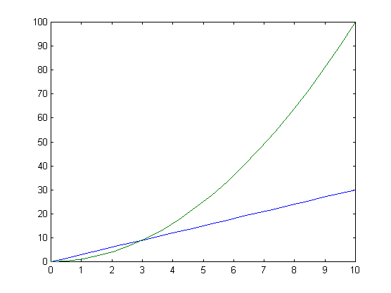
Running
time
O(n²)
O(n)
N
Constants can make o(n) perform worse for low values

Slide 32
Time n=1 n=2 n=4 n=8 n=16 n=32
1 1 1 1 1 1 1
logn 0 1 2 3 4 5
n 1 2 4 8 16 32
nln 0 2 8 24 64 160
n2 1 4 16 64 256 1024
n3 1 8 64 512 4096 32768
2^n 2 4 16 256 65536 4294967296
n! 1 2 24 40326 2.1x10¹³ 2613x10³³

Slide 33
Determining Complexity in a Program:
1. Sequence of statements:
statement 1;
statement 2;
...
statement k;
total time = time(statemnt 1) + time(statemnt 2) + ...time(statemnt k)
2. If-then-else statements:
total time = max(time(sequence 1),time(sequence 2)). For example, if sequence 1 is O(N) and sequence 2 is O(1) the worst-case time for the whole if-then-else statement would be O(N).
3. Loops for (i = 0; i < N; i++) {
sequence of statements
}
The loop executes N times, so the sequence of statements also executes N times. Since we assume the statements are O(1), the total time for the for loop is N * O(1), which is O(N) overall.

Slide 34
Nested loops
for (i = 0; i < N; i++) {
for (j = 0; j < M; j++) {
sequence of statements
}
}
The outer loop executes N times. Every time the outer loop executes, the inner loop executes M times. As a result, the statements in the inner loop execute a total of N * M times. Thus, the complexity is O(N * M). In a common special case where the stopping condition of the inner loop is j < N instead of j < M (i.e., the inner loop also executes N times), the total complexity for the two loops is O(N2).

Slide 35
Determining Complexity
look for some clues and do some deduction to
arrive at the answer. Some obvious things—
Break the algorithm down into steps and analyze the complexity of each. For example, analyze the body of a loop first and then see how many times that loop is executed.
Look for for loops. These are the easiest statements to analyze! They give a clear upper bound, so they’re usually dead giveaways.—sometimes other things are going on in the loop which change the behavior of the algorithms.
Look for loops that operate over an entire data structure. If you know the size of the data structure, then you have some ideas about the running time of the loop.
Loops, loops. Algorithms are usually nothing but loops, so it is imperative to be able to analyze a loop!

Slide 36
General Rules for determining O
1. Ignoring constant factors: O(c f(N)) = O(f(N)), where c is a constant; e.g. O(20 N³) = O(N³)
2. Ignoring smaller terms: If a<b then O(a+b) = O(b), for example O(N²+N) = O(N²)
3. Upper bound only: If a<b then an O(a) algorithm is also an O(b) algorithm. For example, an O(N) algorithm is also an O(N²) algorithm (but not vice versa).
4. N and log N are "bigger" than any constant, from an asymptotic view (that means for large enough N). So if k is a constant, an O(N + k) algorithm is also O(N), by ignoring smaller terms. Similarly, an O(log N + k) algorithm is also O(log N).
5. Another consequence of the last item is that an O(N logN+N) algorithm, which is O(N(log N + 1)), can be simplified to O(NlogN).

Slide 37
Bubble sort -- analysis
void bubble_sort(int array[ ], int length)
{
int j, k, flag=1, temp;
for(j=1; j<=length && flag; j++)
{ flag=0;
for(k=0; k < (length-j); k++)
{ if (array[k+1] > array[k])
{
temp=array[k+1];
array[k+1]= array[k];
array[k]=temp;
flag=1;
} } } }
N(N-1) = O(N²)

Slide 38
Review of Log properties
log_{b} x = p if and only if b^{p} = x (definition)
log_{b} x*y = log_{b} x + log_{b} y
log_{b} x/y = log_{b} x - log_{b} y
log_{b} x^{p} = p log_{b} x which implies that (x^{p})^{q} = x(^{pq})
log_{b} x = log_{a} x * log_{b} a
log to the base b and the log to the base a are related by a constant factor. Therefore, O(N log_{b} N), is the same as O(N log_{a} N) because the big-O bound hides the constant factor between the logs. The base is usually left out of big-O bounds, I.e. O(N log N).

Slide 39
// this function returns the location of key in the list
// a -1 is returned if the value is not found
int binarySearch(int list[], int size, int key)
{
int left, right, midpt;
left = 0; right = size - 1;
while (left <= right)
{
midpt = (int) ((left + right) / 2);
if (key == list[midpt])
{ return midpt; }
else if (key > list[midpt])
left = midpt + 1;
else right = midpt - 1;
}
O(logn)

Slide 40
When do constants matter?
When the problem size is “small”
N 100*N N²/100
10² 10⁴ 10²
10³ 10⁵ 10⁴
10⁴ 10⁶ 10⁶
10⁵ 10⁷ 10⁸
10⁷ 10⁹ 10¹²

Slide 41
Running Time
Also interested in Best Case and Average Case
Mission critical -- worst case important
Merely inconvenient -- may be able to get away with Avg/Best case
Avg case must consider all possible inputs

